Slide 1
Preamble Synonyms

Slide 2
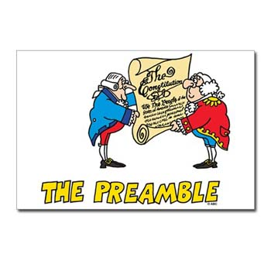
“We the People of the United States, in order to form a more perfect union, establish justice, insure domestic tranquility, provide for the common defense, promote the general welfare, and secure the blessings of liberty to ourselves and our posterity, do ordain and establish this constitution for the United States of America.”

Slide 3
Goals of the Preamble Synonym Match :
We the People…
In order to form a more perfect union
Establish justice
Insure domestic tranquility
Provide for the common defense
Promote the general welfare
Secure the blessings of liberty for ourselves and our posterity
Synonym Match:
home
fairness
country
freedom
future children
create
safety
peace
well being

Slide 4
Goals of the Preamble Synonym Match:
We the People…
In order to create a more perfect country
Establish fairness
Insure home peace or peace at home
Provide for the Common safety
Promote the General well being
Secure the Blessings of freedom for ourselves and our future children

